Slide 1
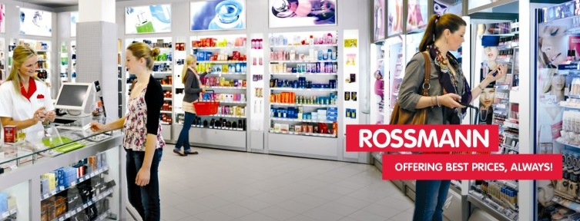
Pharmaceutical Sales prediction across multiple stores

Slide 2
Overview
The finance team wants to forecast sales in all their stores across several cities six weeks ahead of time. Managers in individual stores rely on their years of experience as well as their personal judgment to forecast sales.
The data team identified factors such as promotions, competition, school and state holidays, seasonality, and locality as necessary for predicting the sales across the various stores.
Our job is to build and serve an end-to-end product that delivers this prediction to analysts in the finance team.

Slide 3
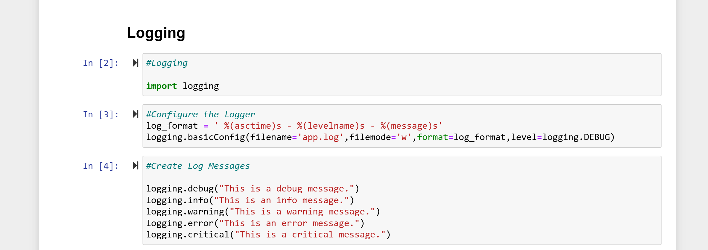
Logging

Slide 4
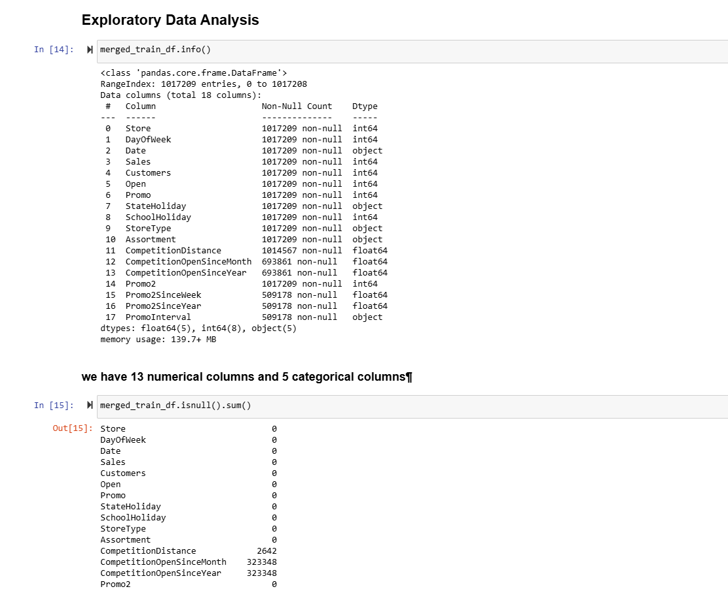
Preprocessing and Cleaning

Slide 5
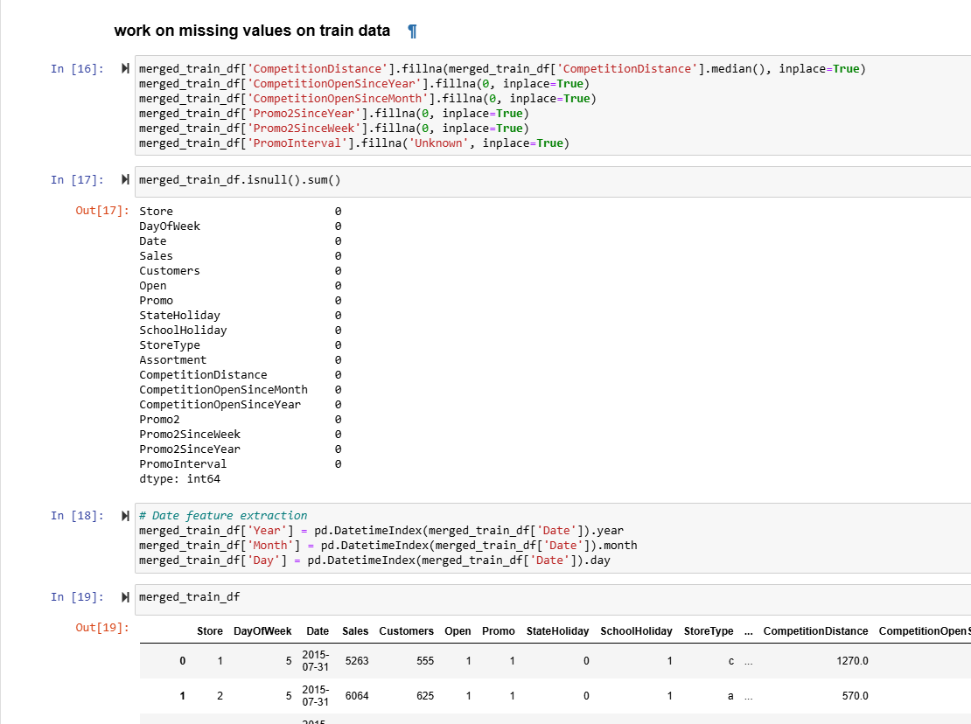
Missing Value

Slide 6
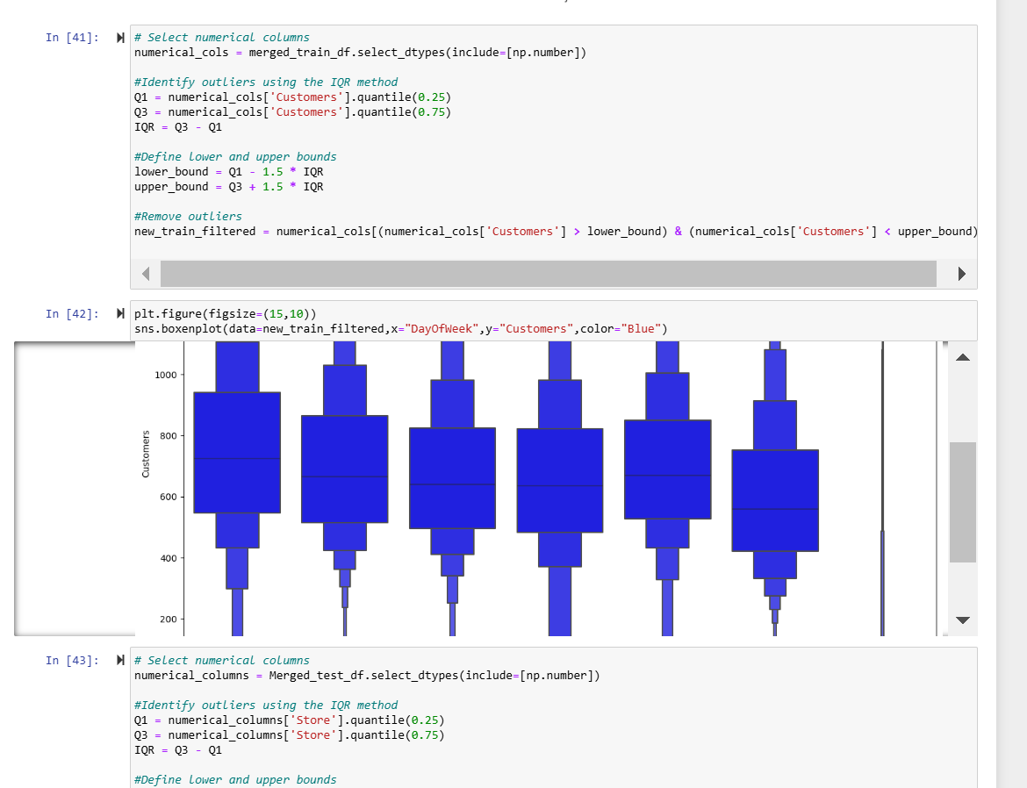
Find and Remove outliers

Slide 7
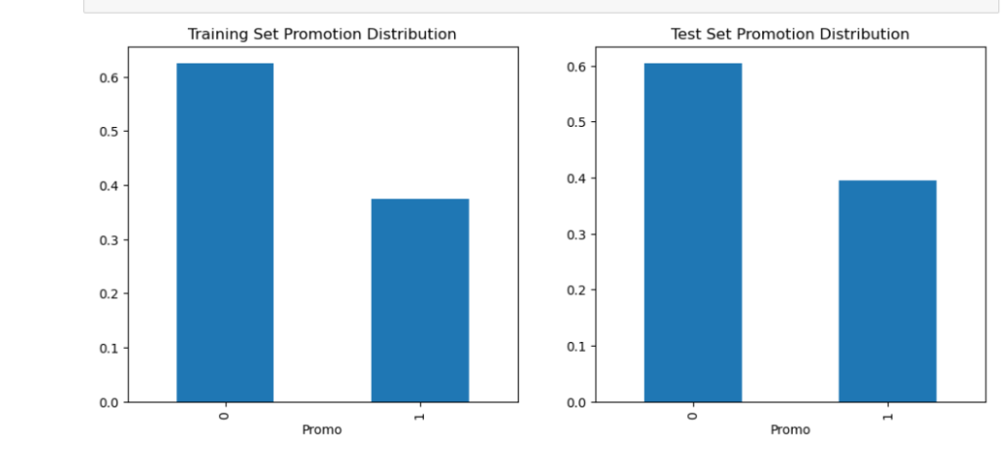
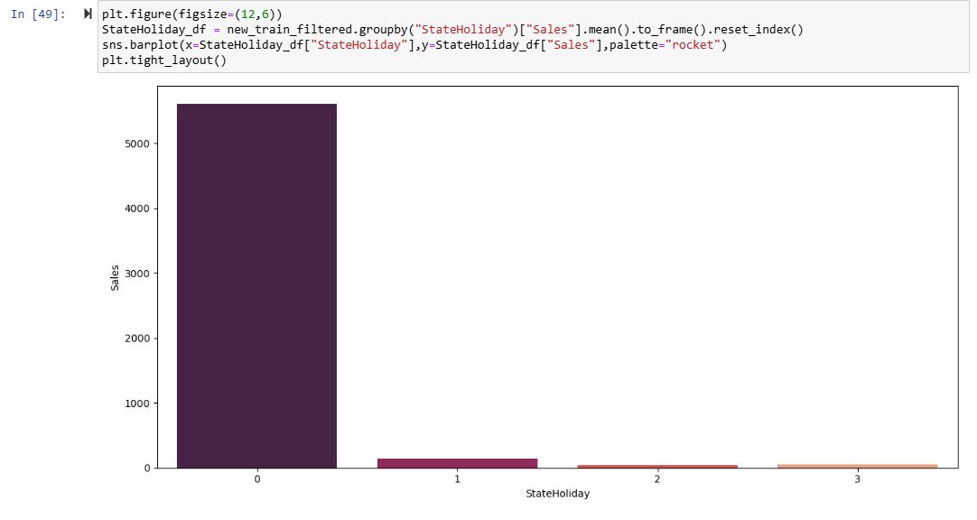
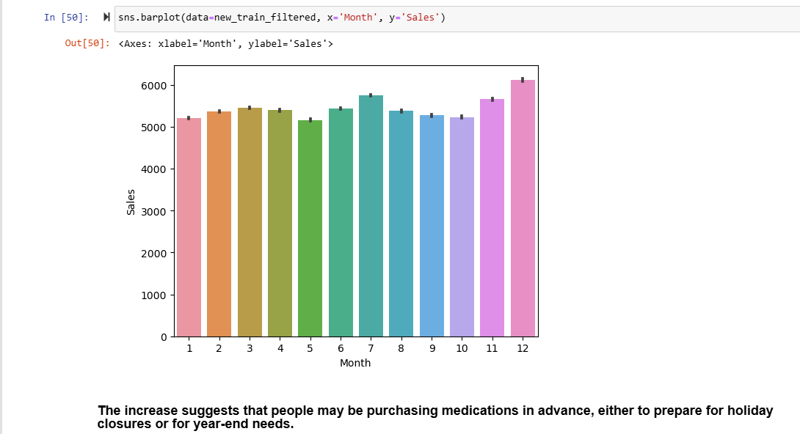
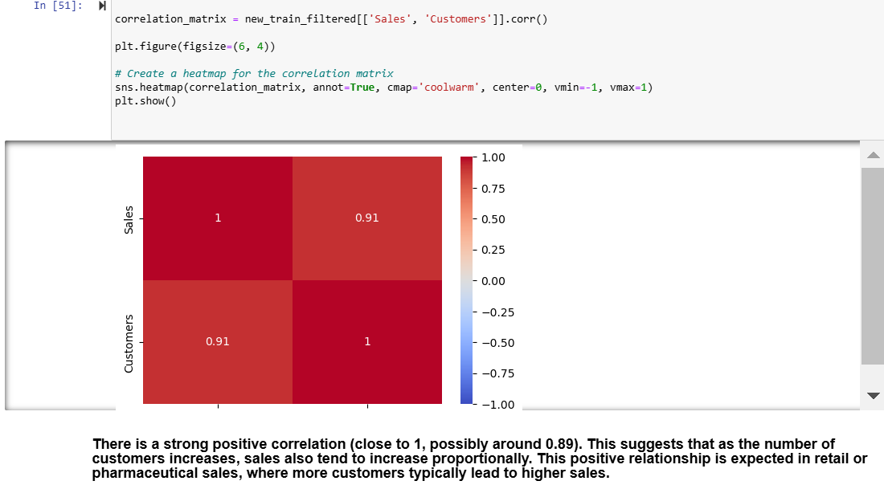
Task 1 - Exploration of customer purchasing behaviour

Slide 8
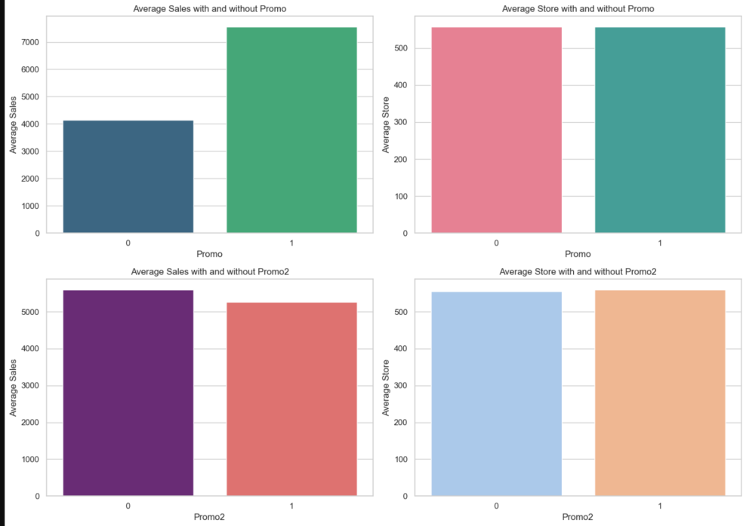
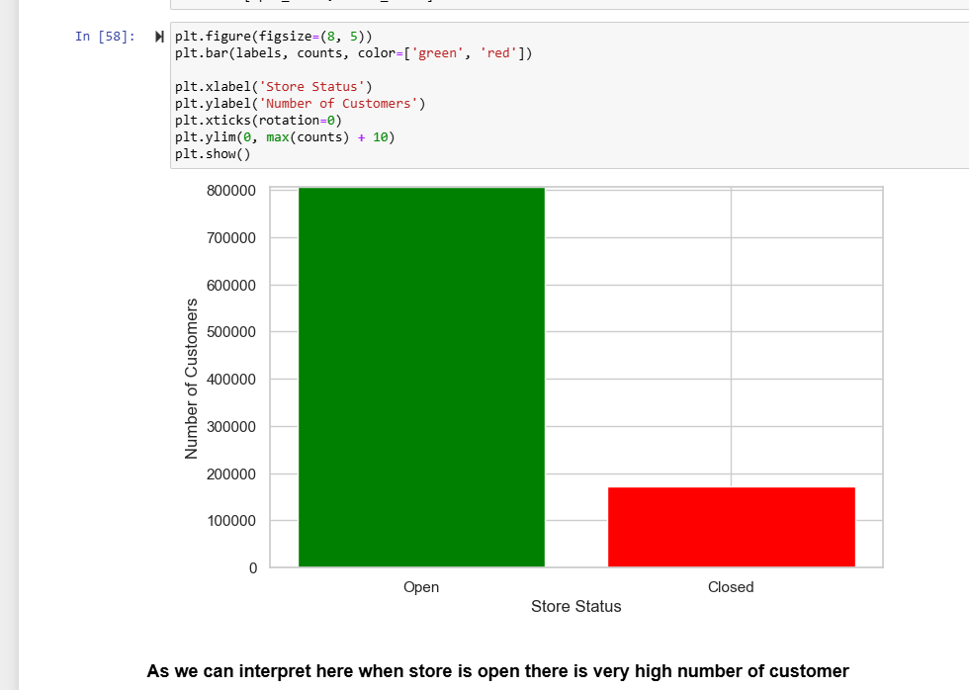
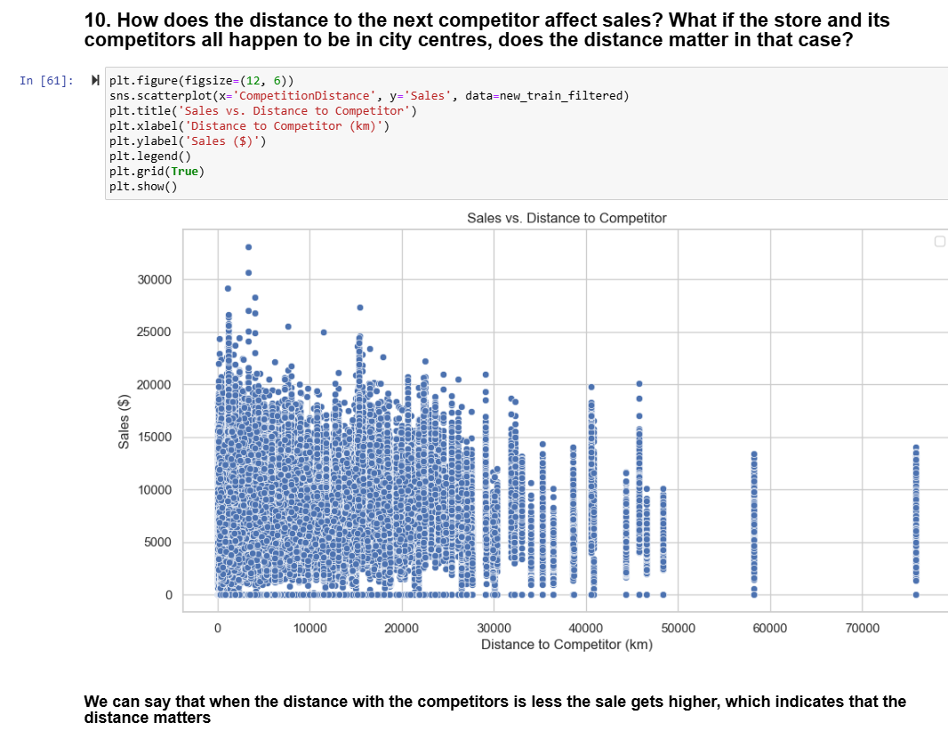

Slide 9
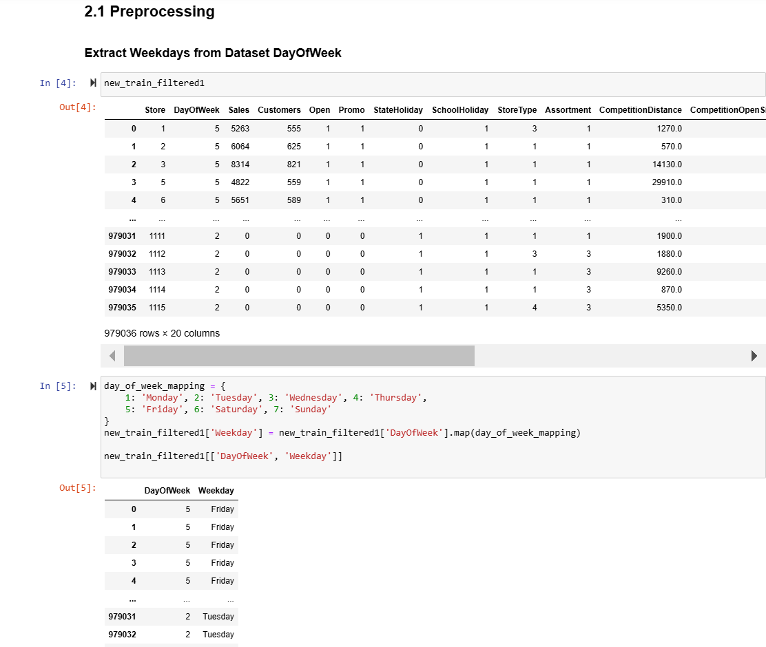
Task 2 : Preprocessing

Slide 10
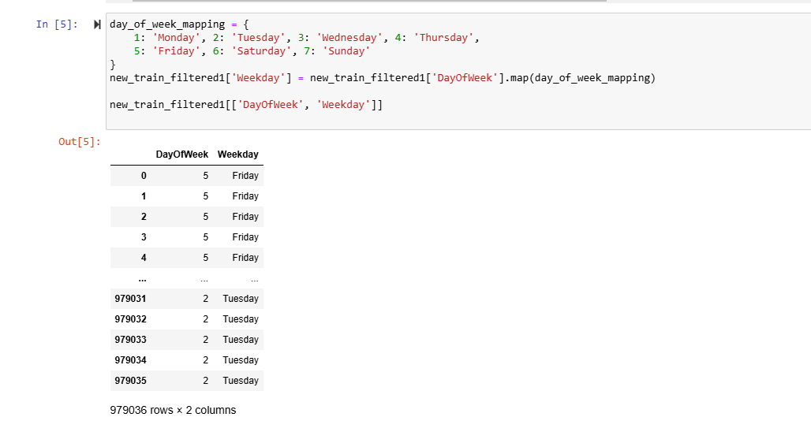
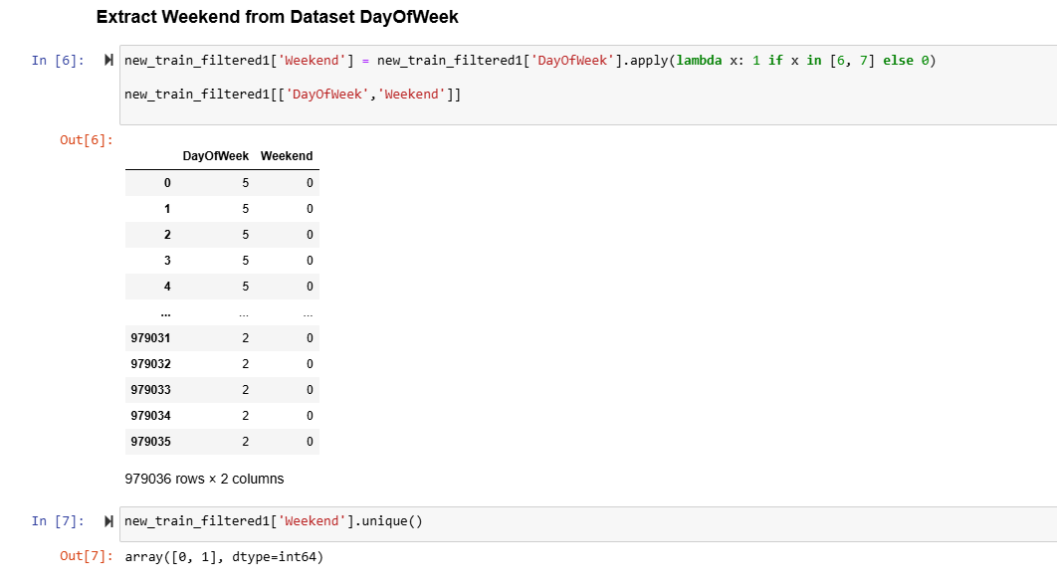
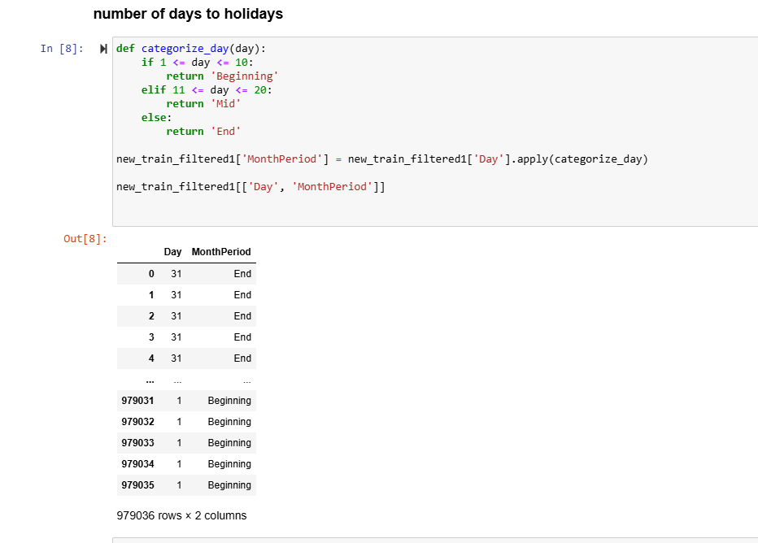
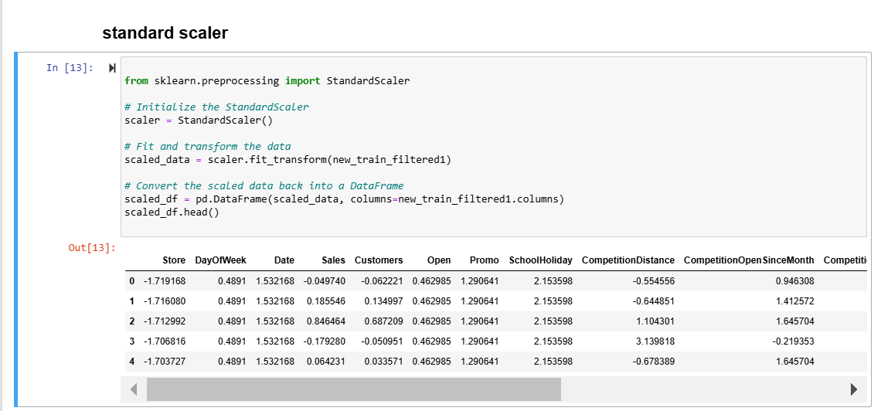

Slide 11
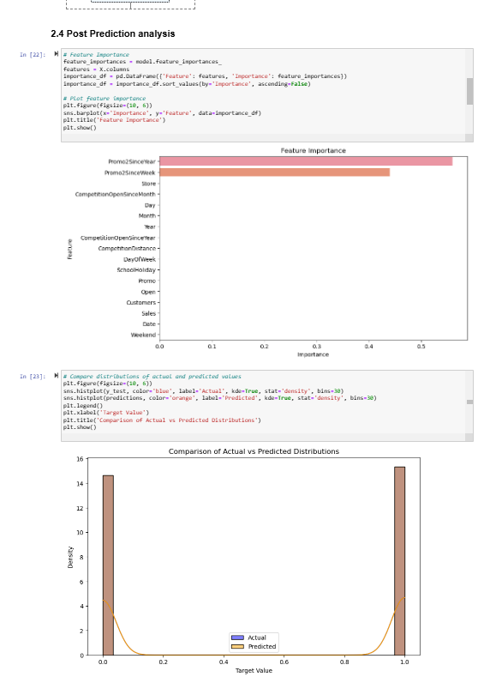
2.4 Post Prediction analysis

Slide 12
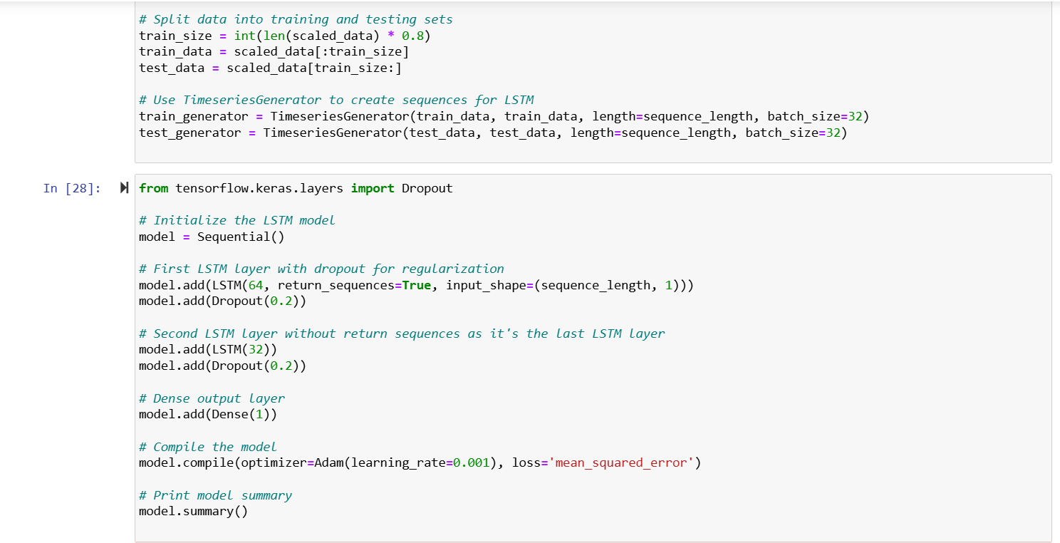
Build a LSTM Regression model to predict the next sale.

Slide 13
Conclusion
Sales are strongly correlated to the numbers of customers
For all stores, promotion leads to increased sales ad customers
Stores open during school holidays have more sales than on normal days
More stores are open during holidays than on public holidays
Sales increase during Christmas week

